Slide 1
Design Technology at Stoke Park Infant School
January 2022

Slide 2
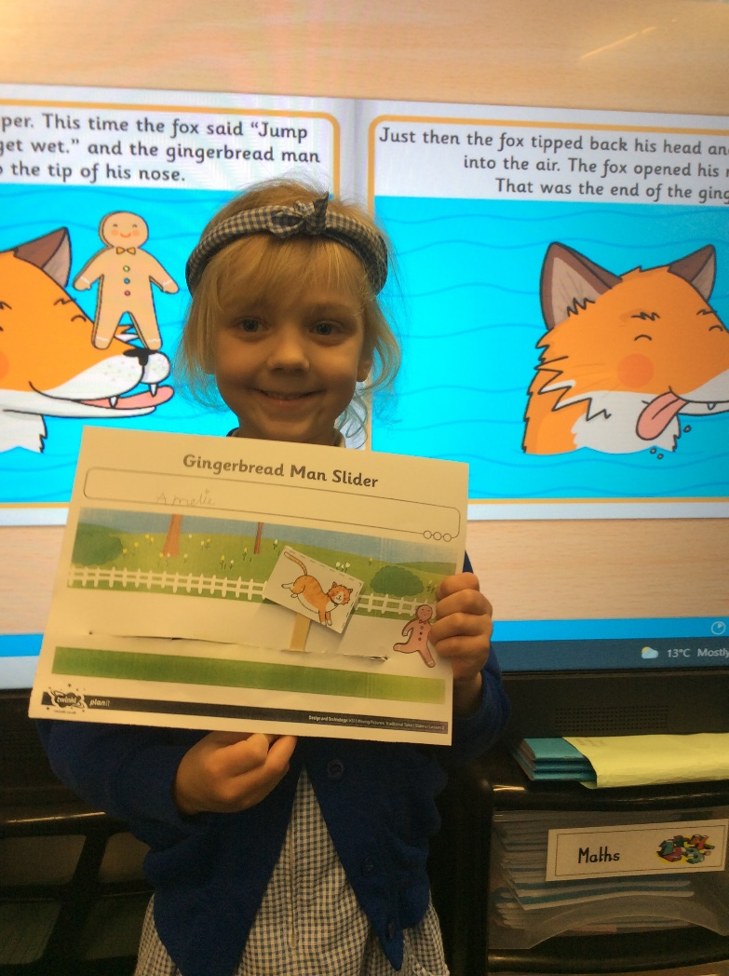
In Year 1 we make a slider picture and a lever picture.

Slide 3
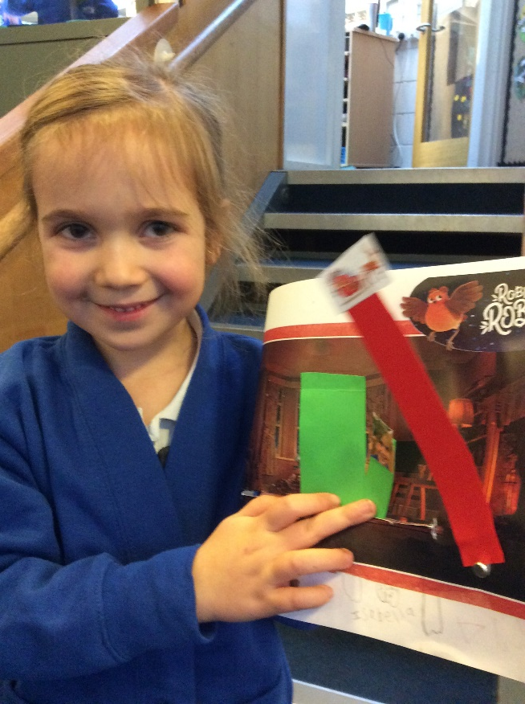
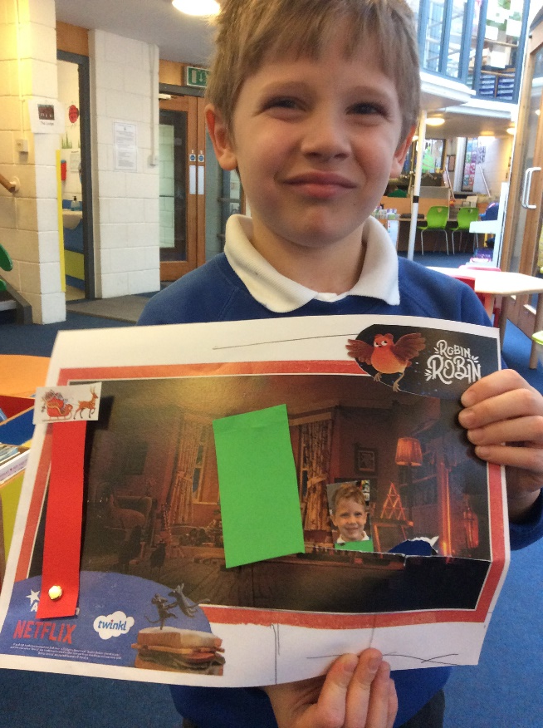
We explore concrete examples of sliders and levers.
We make pictures which use both sliders and levers.

Slide 4
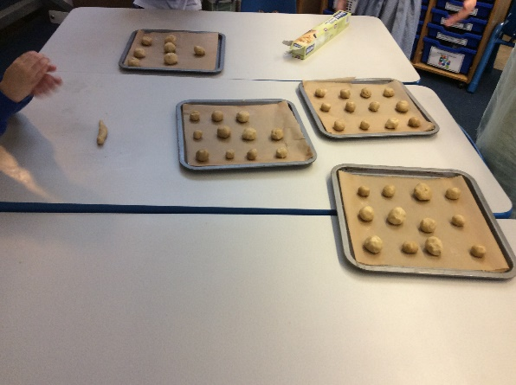
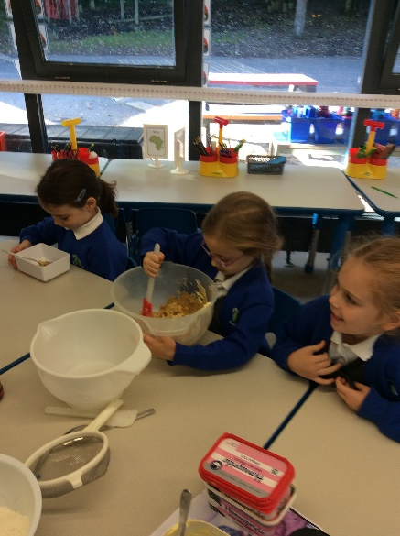
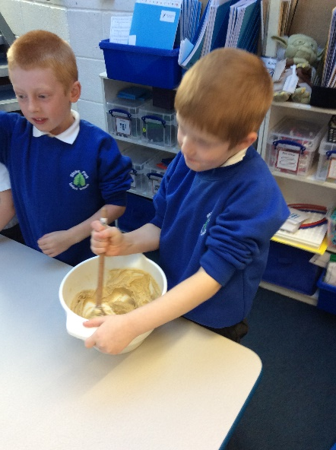
In Year 2 we use scales, sieves and spoons to mix cookie dough. We choose the flavouring we want to add.

Slide 5
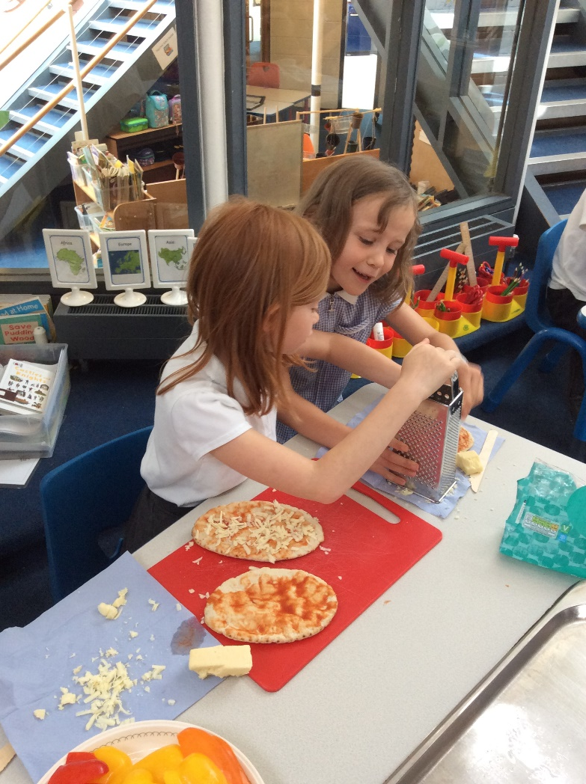
We also use graters and knives to prepare food.

Slide 6
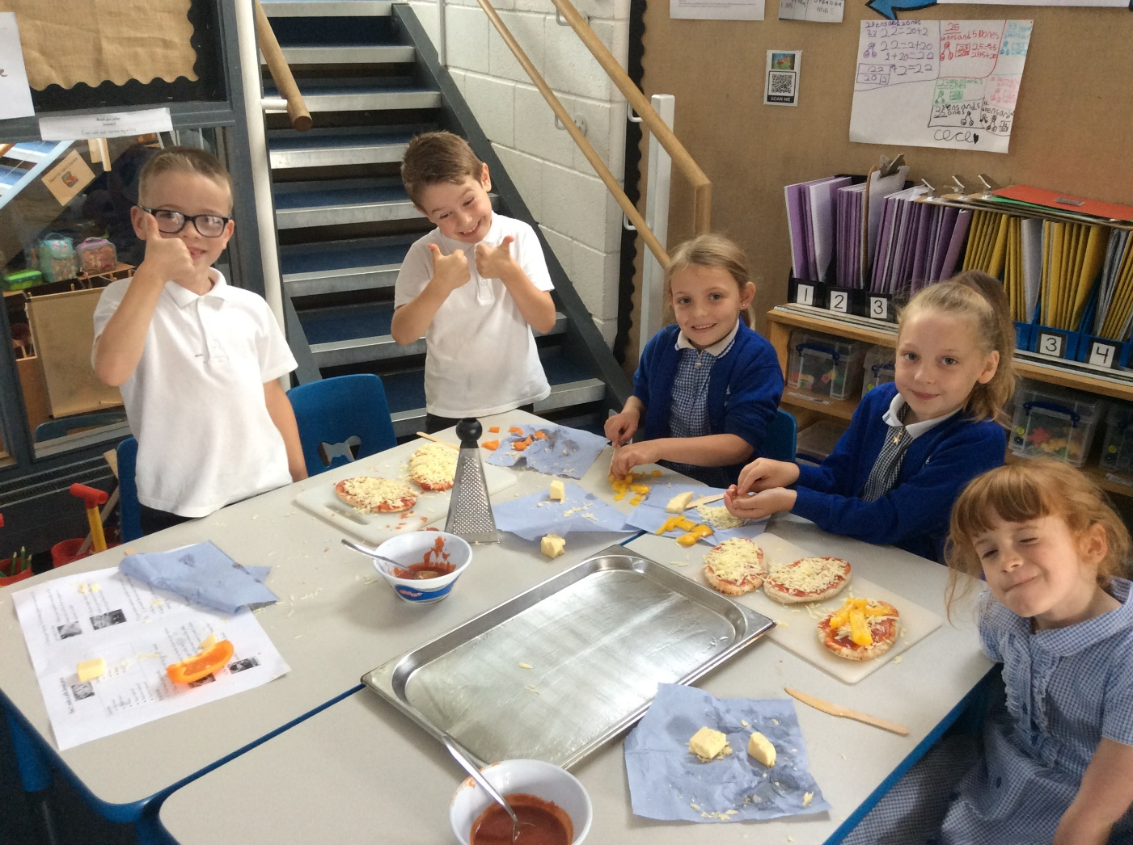
We decide which toppings we want on our pizza!

Slide 7
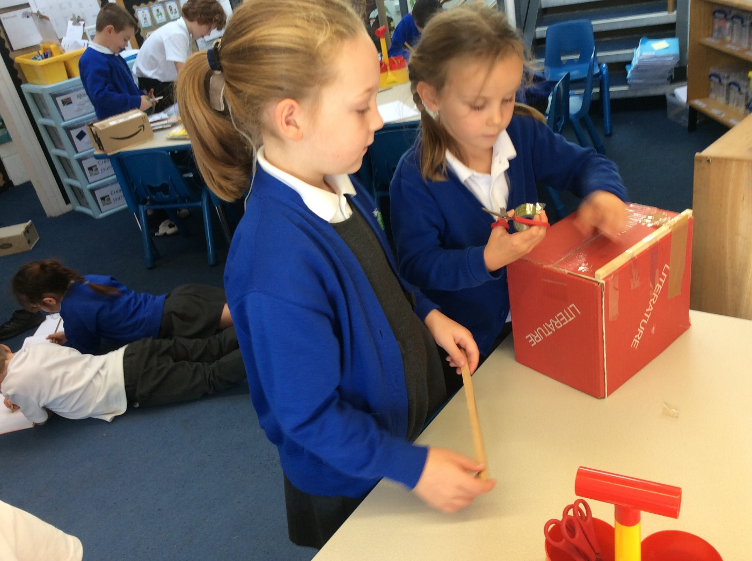
We work together to retrieve skills we have used before.

Slide 8
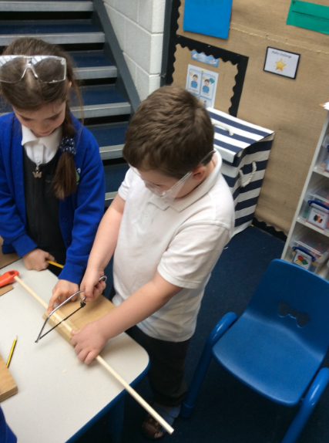
We understand safety when using tools.

Slide 9
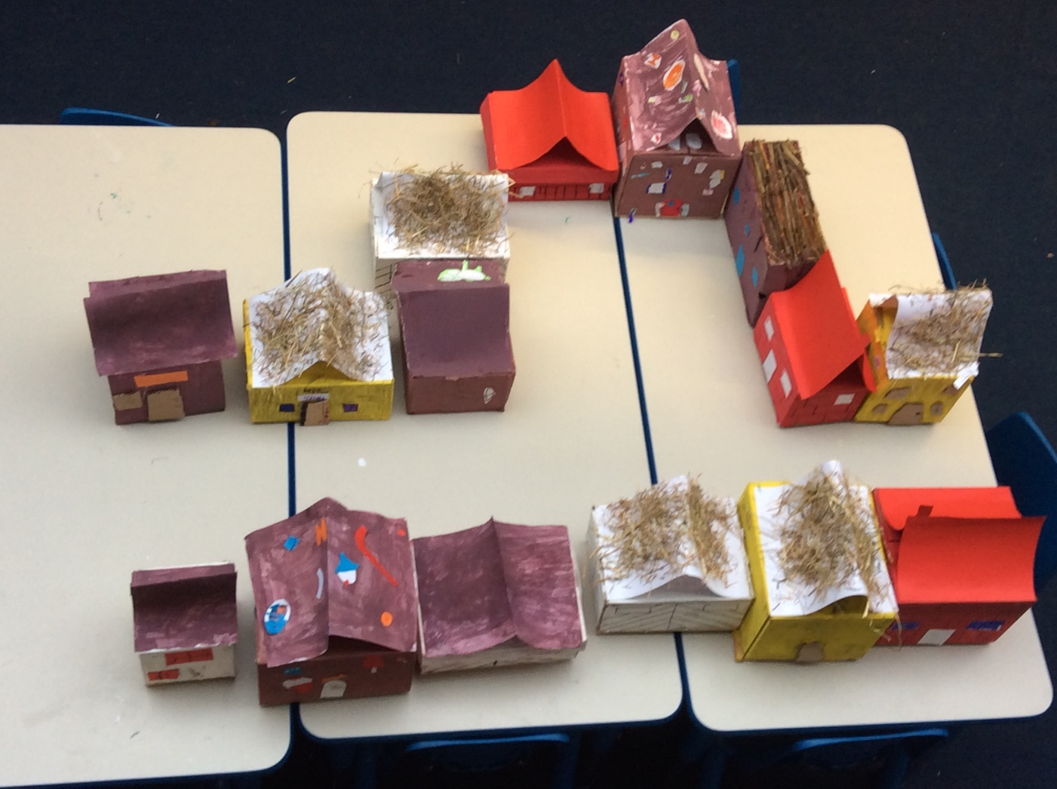
We make our houses then evaluate the finished products, to see whether they meet the purpose.

Slide 10
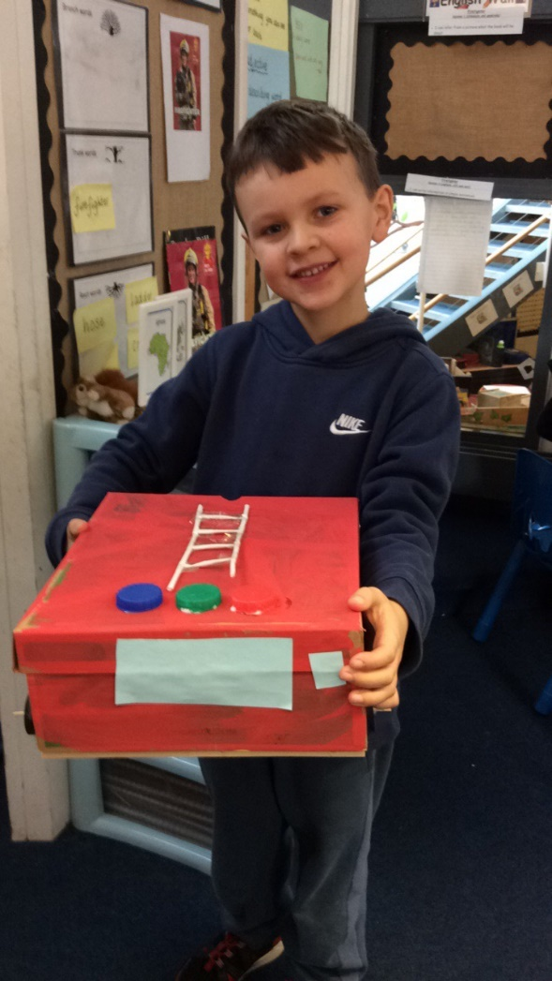
We design, make and decorate emergency vehicles.

Slide 11
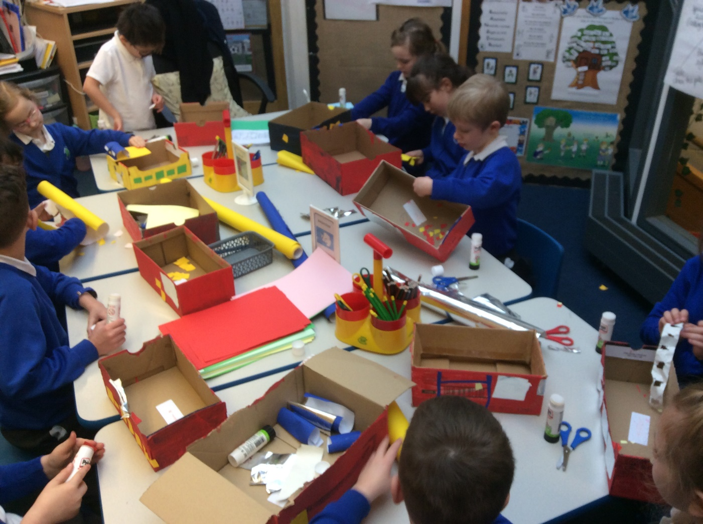
We add details to make our vehicles look like real emergency ones!

Slide 12
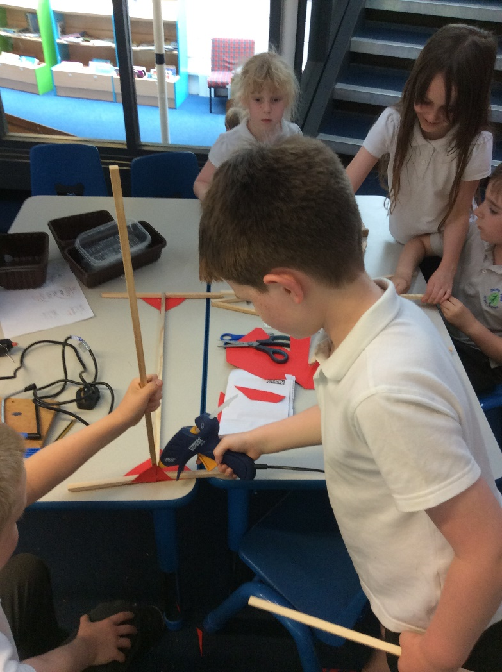
By the end of Year 2 we can use glue guns independently (retrieving skills, spaced learning from earlier in the key stage).

Slide 13
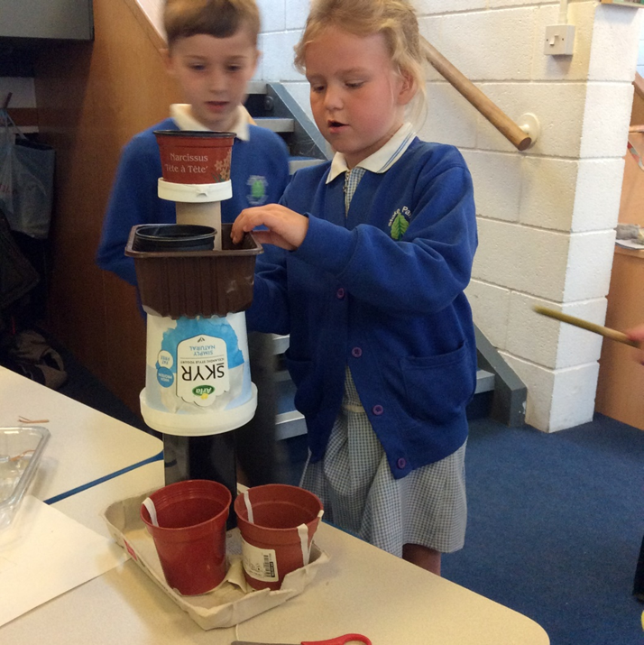
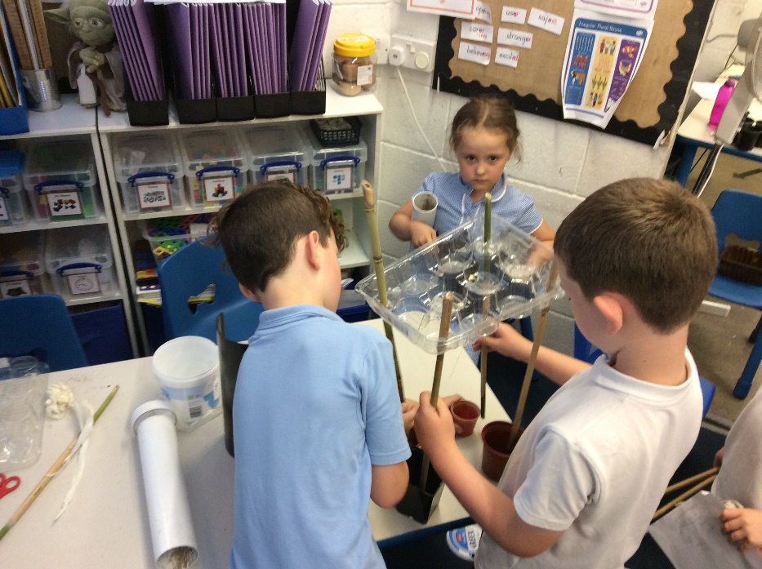
We design and make plant holders then test our structures to see if they are stable. We adapt if necessary. We use prior skills and knowledge (interleaving).

