Slide 1
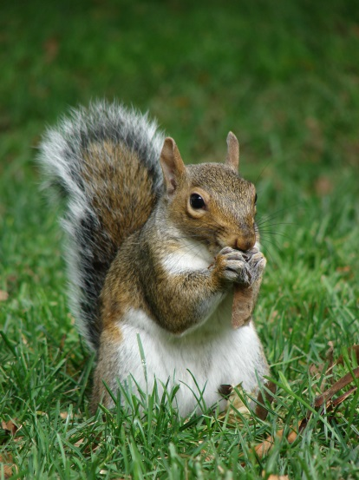
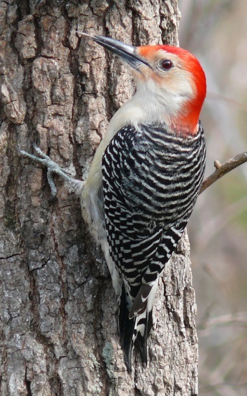
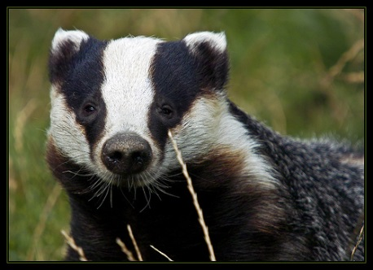
Welcome To
Year 2
Miss Perkins,
Mrs Wilson,
Mrs Hewlett, Mrs Froy and Mrs Scott
Mr Firman,
Mrs Lewis and
Mrs Andrews
Mrs Kniola,
Mrs Browne, Ms Gingham and Mrs Froy
High Level Teaching Assistant – Ms Harding
Speech & Language Assistant – Mrs Cooper

Slide 2
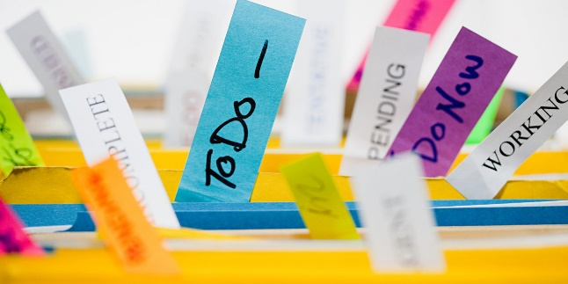
Let’s get organised!
Time keeping and attendance
(Hampshire Policy. No holidays -fixed penalties)
Arrive 8:45-9:00 Collect at 3:10
Uniform/PE Kit named – even shoes please!
Slippers and wellies
School dinners – usually meat or vegetarian choice. Cold lunches at the moment.
Healthy choices in lunchboxes – no nuts.
Water in bottles for class. Squash is allowed at lunch time.
Books in book bags - not drinks bottles please
Show and tell – Spotlight

Slide 3

Class Dojo
Class Dojo allows us to send you photos and information about your child’s learning either individually or as a whole class.
We pride ourselves on having a good two way working relationship with all our parents in the school.
Please feel free to send class teachers a message if there is anything you would like us to know, or if you have a question – preferably between 8:30 – 5:00
Any urgent messages, please phone the school office.

Slide 4
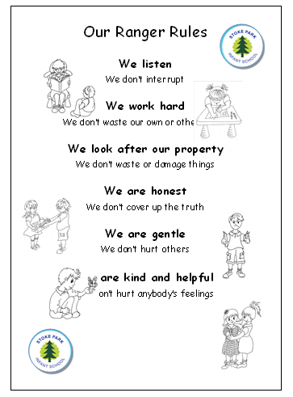
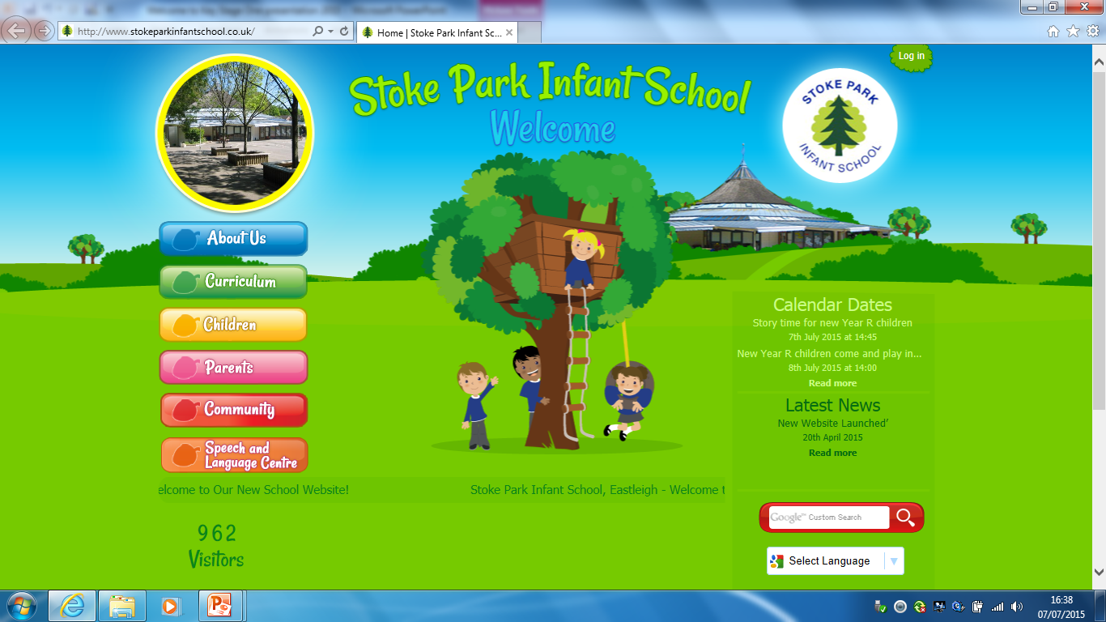

Making the right choices?
Ranger Rules – When the children follow the rules, they will stay in the treehouse. If they do something exceptional then they may put their name on the bird and ‘fly high’

Slide 5
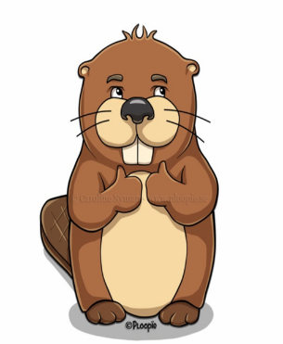

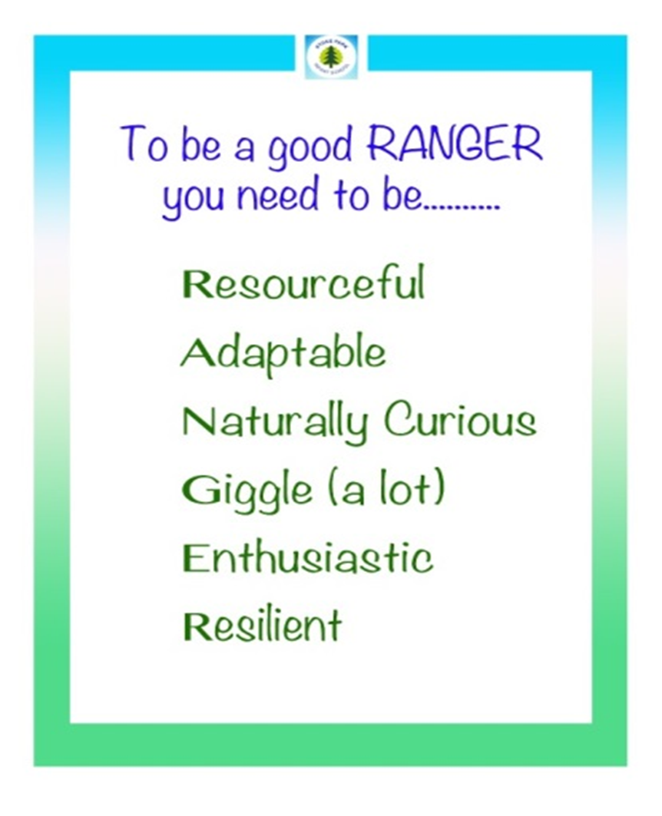




Ranger Skills
Behaviours for learning
Adaptable Spider
Resourceful Beaver
Naturally Curious Bear
Giggly Mouse
Enthusiastic Otter
Resilient Ant

Slide 6

Celebrations
Dojo points
Children will collect Dojo points based on our Ranger Rules and Ranger Skills. These points work towards a ‘special’ certificate:
Red - 50
Yellow - 100
Green - 150
Bronze - 200
Silver - 250
Gold - 300
Ruby - 350
Diamond - 400
Platinum - 450
Head teacher’s certificate - 500
Other certificates:
Class Ranger of the Week
Teacher choice
Best seats in the House
Stickers:
Ranger book
Awesome Author
Maths Magician
Visiting Mrs Charles or Mrs Brennan
Spin the Wheel
Class with most regular readers
Classes with best attendance

Slide 7
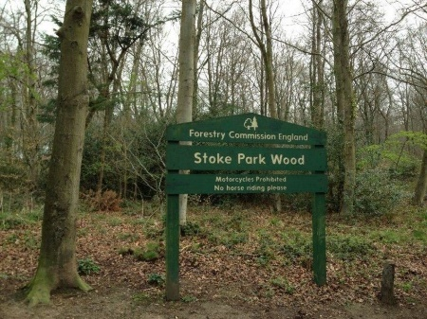


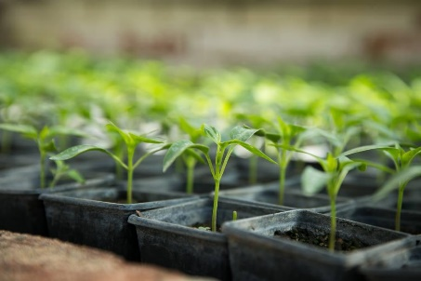
An engaging curriculum
From the Forest to the Sea
Could a fairytale
be set in Bishopstoke?
Is the sea kind or cruel?
999 What’s your Emergency?
How do we stay safe?
What a Wonderful World
How do we know about our planet?
Should we ever stop learning about our planet??
Exciting hooks
Cross curricular

Slide 8

Teaching and Learning
National Curriculum
All children are working towards the same end of year expectations
All children work towards the same objective, with work being differentiated according to needs
Children’s learning is continually tracked to ensure every child makes progress in every lesson
Notes:
- Interventions to support as appropriate
More able children – challenged with breadth and depth rather than linear learning
Children may have the same objective but work towards it in a different way – differentiated resources etc
Parents informed in Nov, March, June if children are not meeting expectations. (close to or not on track)

Slide 9
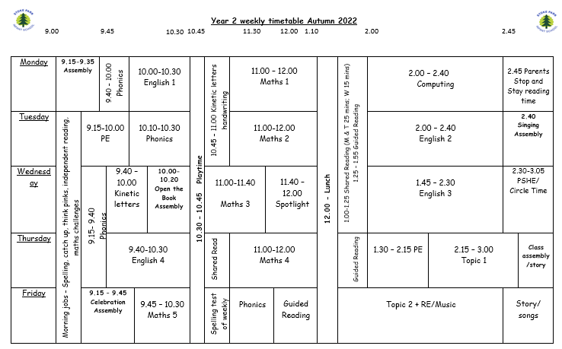
A typical week in Year 2

Slide 10

End of Year 2 SATs tests
2 reading papers
Maths reasoning paper
Maths arithmetic – fluency
Grammar (optional for schools)

Slide 11
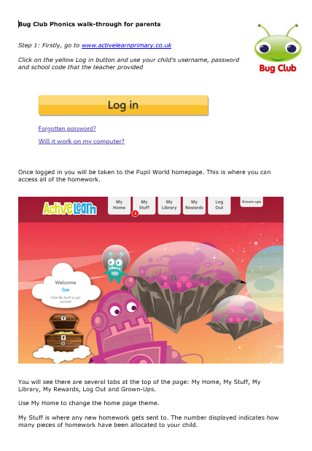


Slide 12
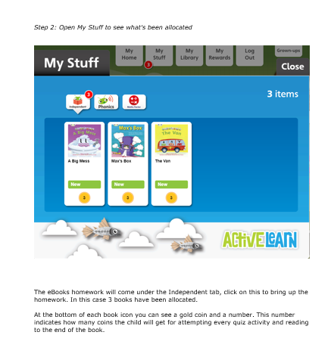

Slide 13
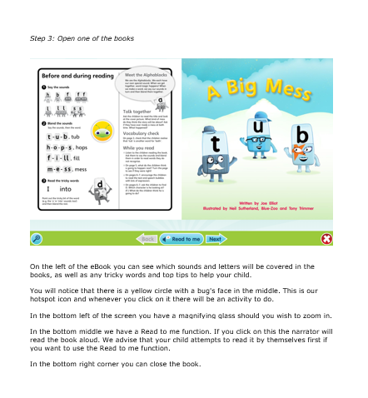

Slide 14
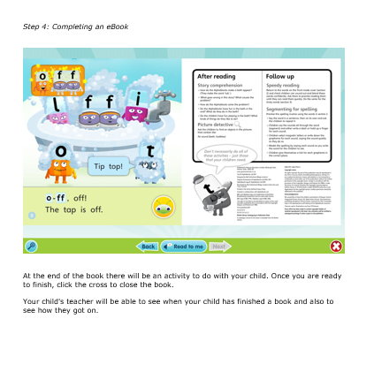

Slide 15
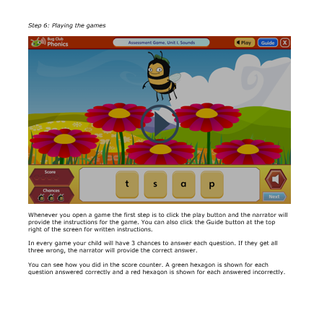

Slide 16
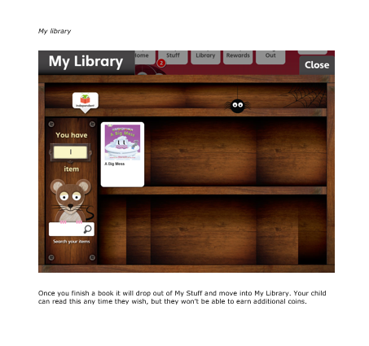

Slide 17
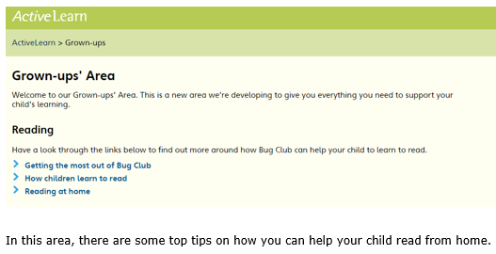

Slide 18
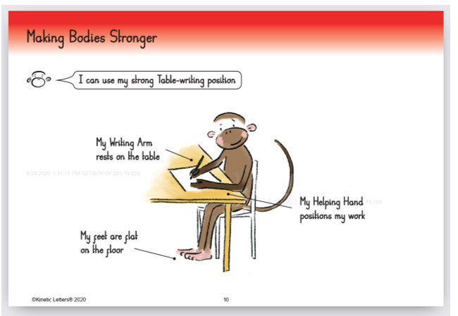
Handwriting – Kinetic Letters

Slide 19
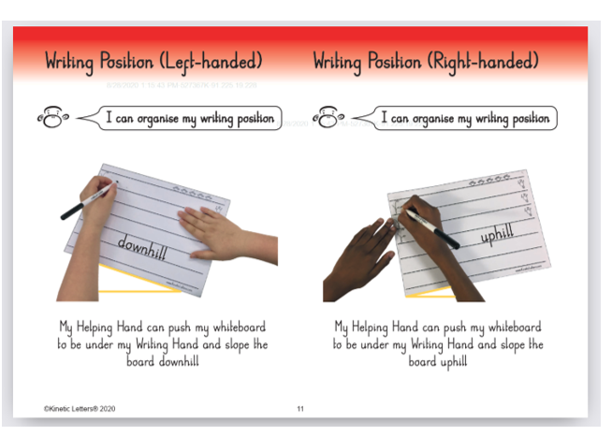

Slide 20
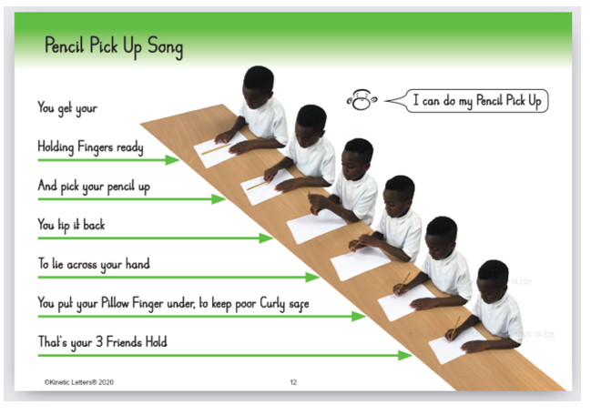

Slide 21
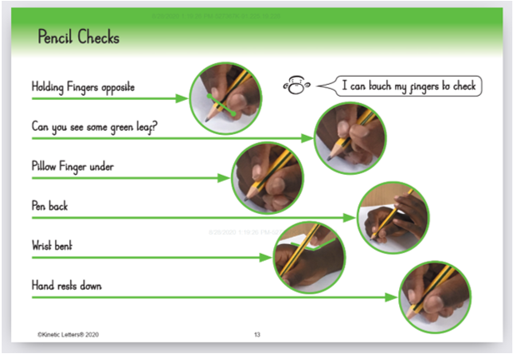

Slide 22
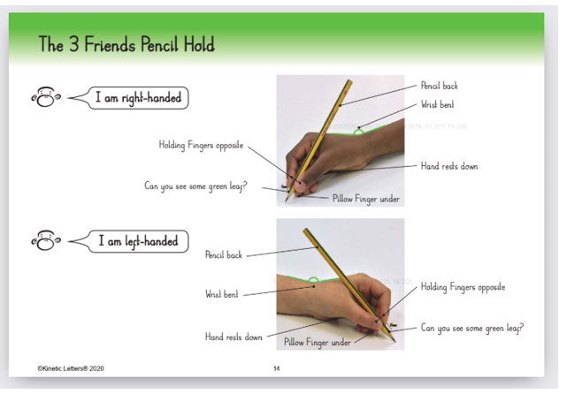

Slide 23
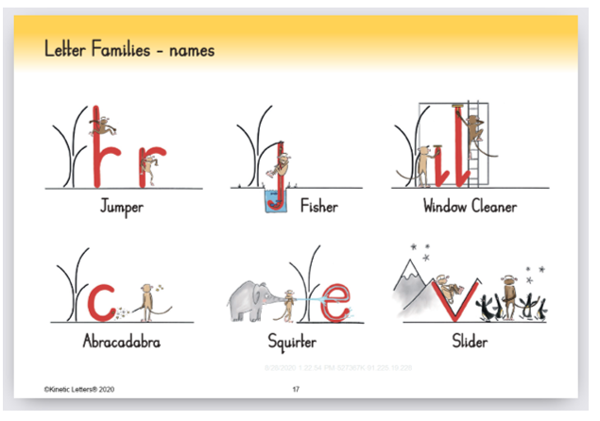

Slide 24
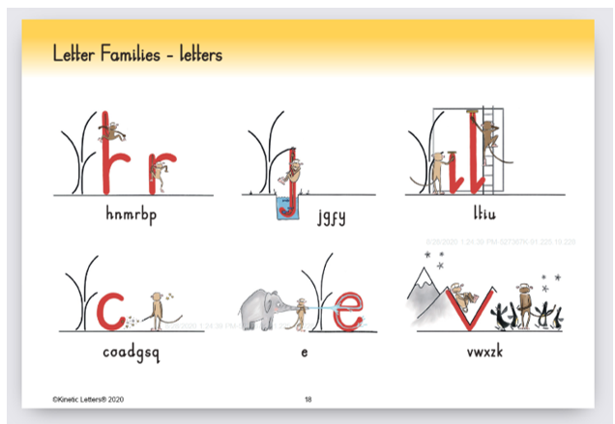

Slide 25
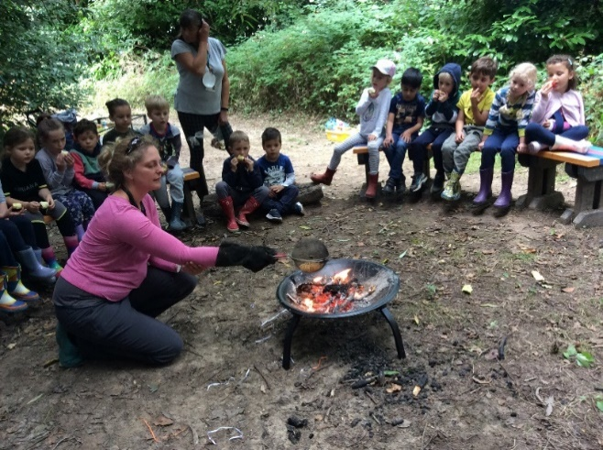
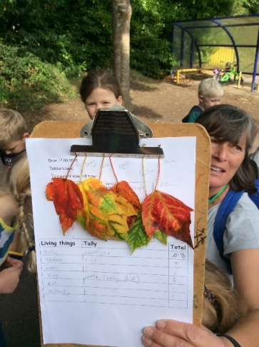
Forest School
Takes place 1 afternoon or morning every 3 weeks
Will take place in the local woods or school grounds
Parent helpers are very welcomed – Please message Mrs Harrison on Class Dojo
Will require children to bring a warm waterproof coat, waterproof trousers, wellies, a warm set of home clothes to wear into the woods

Slide 26
Every child can read
Children who are readers have better life chances – we want this for our children.
  Developing a love of reading can be more important for a child’s educational success than their family’s socio-economic background.
  - The Organization for Economic Cooperation and Development
  Young people who enjoy reading very much are nearly five times as likely to read above the expected level for their age compared with young people who do not enjoy reading at all.
  - Children’s and Young People’s Reading Today, National Literacy Trust, 20121

Slide 27
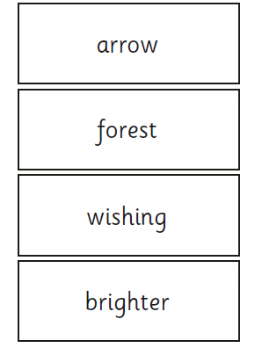
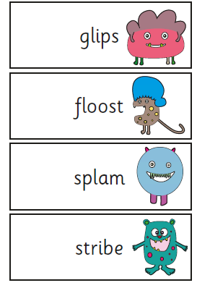
Phonic screening –
End of June if required

Slide 28
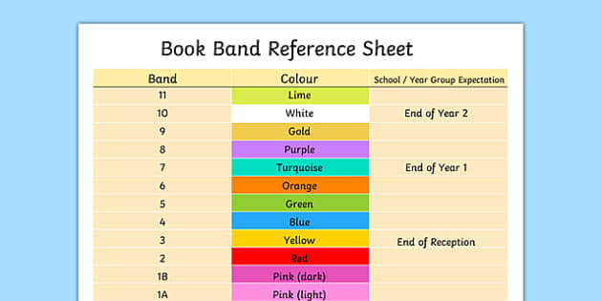
Book Bands
Banding is based on…
- children reading 95% of the words fluently
- vocabulary – unusual and challenging
- page layout
- complex story lines – more than one event
- more characters
- variety of language – adjectives, verbs, adverbs
- comprehension and inference. Can your child infer meaning . from the text and answer direct questions?
By end of the year at least purple to be able to cope with the test and reading 90 words per minute.
Please read daily and send us an update on your child’s read via Dojo please.

Slide 29
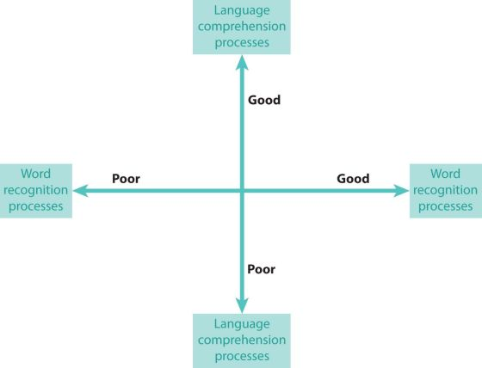

The Simple View of Reading

Slide 30
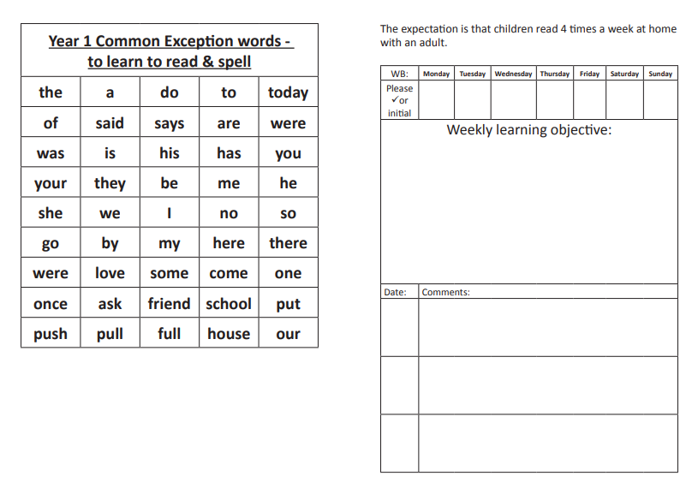

What can you do to help at home?
Reading
As a school we are asking parents to try their best to hear their child/ren at least 4 x reads a week.
Dojo points, stickers and certificates for those children that do.

Slide 31
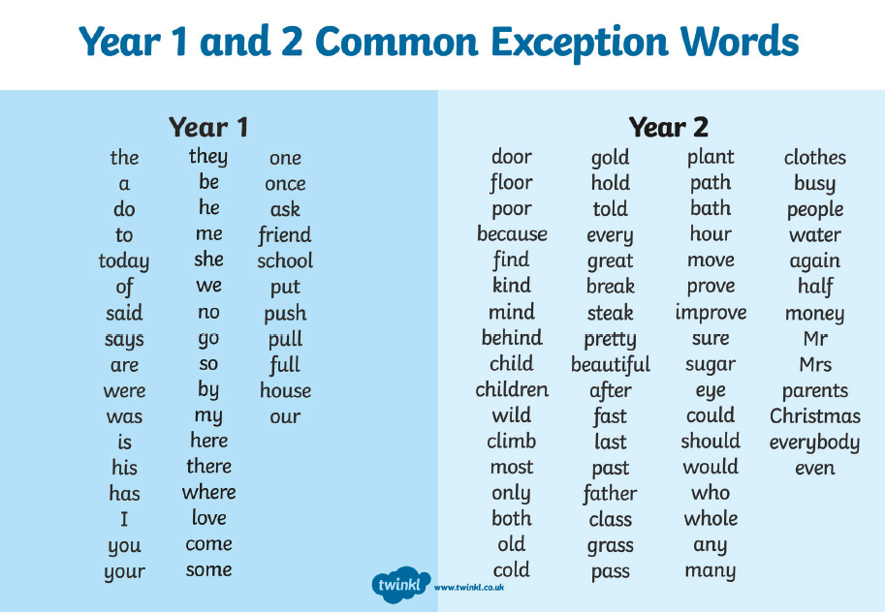

Slide 32
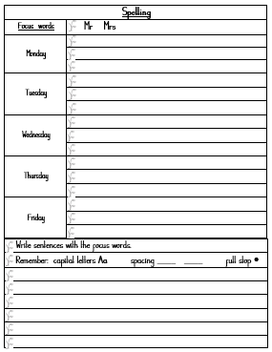
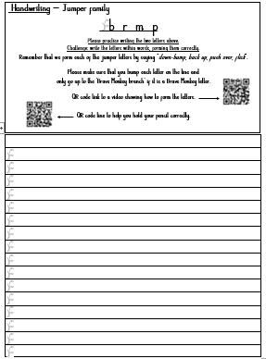
Spelling Sentences and
Kinetic Letters
Spellings and handwriting will be sent home on a Friday with sentences to practise the following week.
Once the sheet is complete please send a photo of it on your child’s Dojo portfolio or bring it into school, and 1 home learning dojo will be awarded.
Both the spellings and handwriting will be practised in school and at home.
Over-learning is really important at this age, especially for words such as “said” and “very” as we don’t want bad spelling habits appearing. The English language is very complicated!

Slide 33
Stop and stay reading
Every Monday 2.45 – 3.10
(this will count as one of your reads)
If you would like to volunteer in class or behind the scenes please let us know.
- This may include - reading common exception words, reading books on Bug Club, maths games, helping with forest school/walks/trips, cutting and laminating, displays in school etc.
(A DBS would need to be completed)

Slide 34

We hope that your child/ren have a brilliant time in Year 2 and we look forward to working with you and your children this year.

